Slide 2

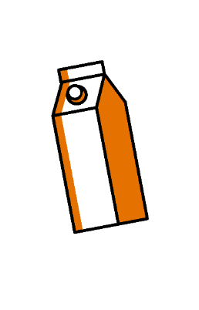

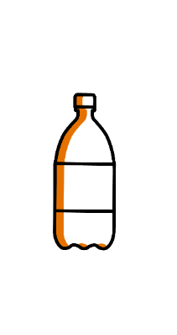



WHAT WE DO
Since 2006, we have been designing and manufacturing bespoke packaging solutions for different types of primary packaging (such as Gable Top cartons, bottles, packs, jars, pots, pouches, vials, etc.), also providing high added-value consulting services..
From secondary and tertiary packaging solutions to handling, from layout design to integrating modules into already existing systems, from consultation to after sales:
ARTEMA PACK IS THE ANSWER TO ALL YOUR NEEDS.
ARTEMA PACK IS:
RELATIONS
We believe in listening to our customers, in dialogue, in people
PROACTIVITY
We are problem solvers, by approach and by profession
PRECISION
Efficiency results from paying attention to the smallest detail

Slide 3




MORE THAN SIMPLE SUPPLIERS
SINGLE CONTACT PERSON
HANDS-ON MENTALITY
CREATIVE AND FLEXIBLE
THE RIGHT PARTNER
Machinery, consultation, services.
Thanks to Galdi's support and expertise, Artema Pack offers complete and reliable solutions for secondary and tertiary packaging, as well as continuous support for the entire packaging line.
From production layout to palletisation, we always strive to remove inefficiencies, with a strong focus on achieving maximum productivity.
Our team is on hand to provide you with support services
that meet your expectations and
requirements.
We believe in open dialogue and long-term partnerships.
Designed to meet your needs,
Artema Pack's flexible solutions:
can be integrated into any production line
adapt to a wide range of primary and secondary packaging applications
evolve with customers thanks to their easy upgrade capabilities
We share the same goals: reliability, flexibility, optimising costs and consumption, as well as speeding up processes.
Each Artema Pack system always comes with an additional component: our experience.

Slide 4







OUR OFFER
HIGH PERSONALISATION
SINGLE CONTACT PERSON
FLEXIBLE MACHINES
AFTER SALES
ADAPTIVE LAYOUTS
ENGINEERING
HIGHLY EFFICIENT TURNKEY AUTOMATION SOLUTIONS

Slide 5












QUALITY IS OUR ONLY STANDARD
GENERAL FEATURES
STANDARD COMPONENTS
Pneumatic system
PLC-based
Stainless steel solutions
Compact and ergonomic machines
Electrical
components - sensors
Gear motors
Hot glue unit
Enhanced connectivity, user-friendly HMI
Extremely flexible, multi-format solutions

Slide 6
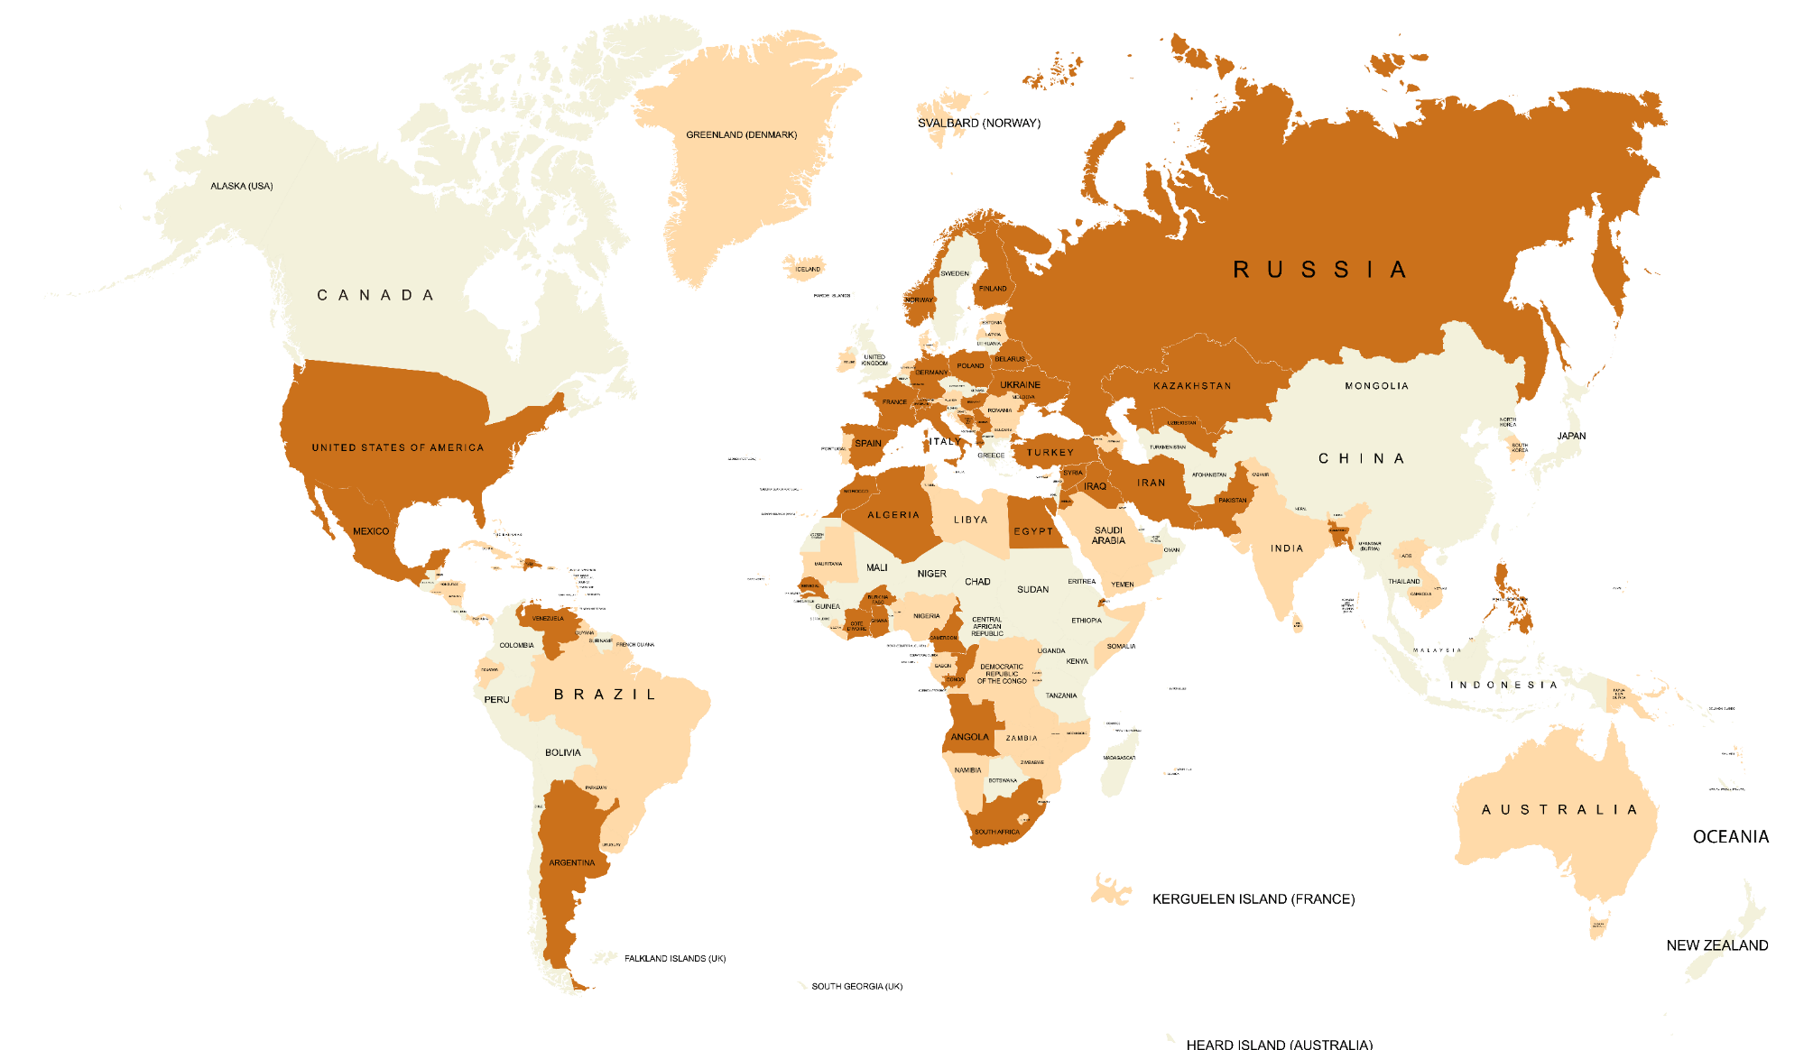
ARTEMA PACK IN THE WORLD

Slide 7
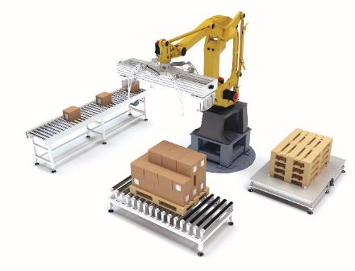
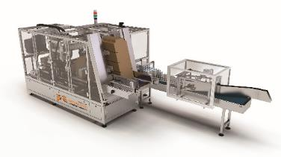
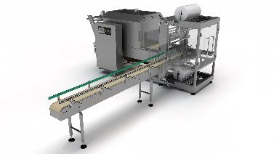
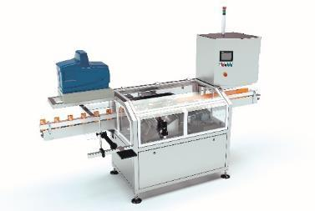
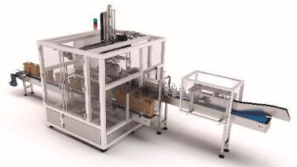
OUR SOLUTIONS
WRAP AROUND
SHRINK WRAPPING MACHINE
TRAY FORMING MACHINES
PICK and PLACE
for American boxes and trays
CRATE PACKERS
for plastic crates
PALETTISATION
AUXILIARY EQUIPMENT
AUTOMATION AND HANDLING

Slide 8

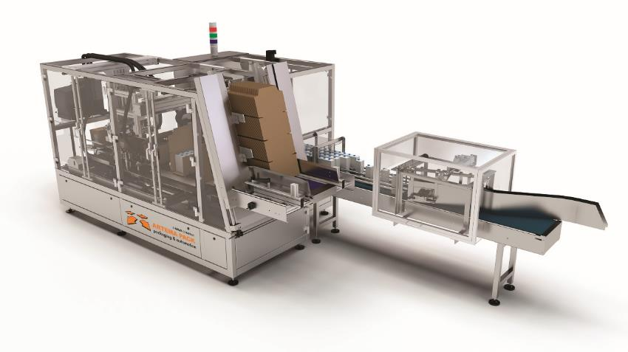




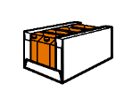





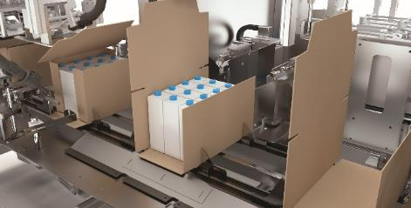
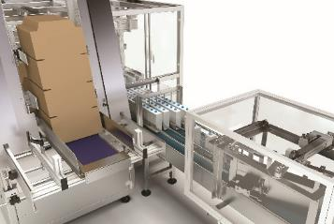
WRAP AROUND
Speed: up to 1,500 boxes/hr (25 boxes/min)
(e.g., 2x3 bundle, 9,000 pieces/hr)
Secondary Packaging
Open Tray
Full case
(with lid)
Tuck top tray
Tray with side panels of different heights
Box with overflap
Pre-scored, easy-to-open box for counter display
Configurations
Right or left product infeed
Front or back infeed conveyor
Single or double infeed conveyor
Inline or 90° degree infeed conveyor

Slide 9
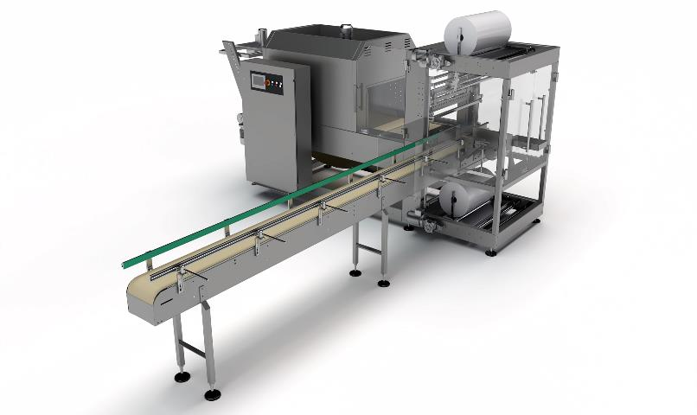
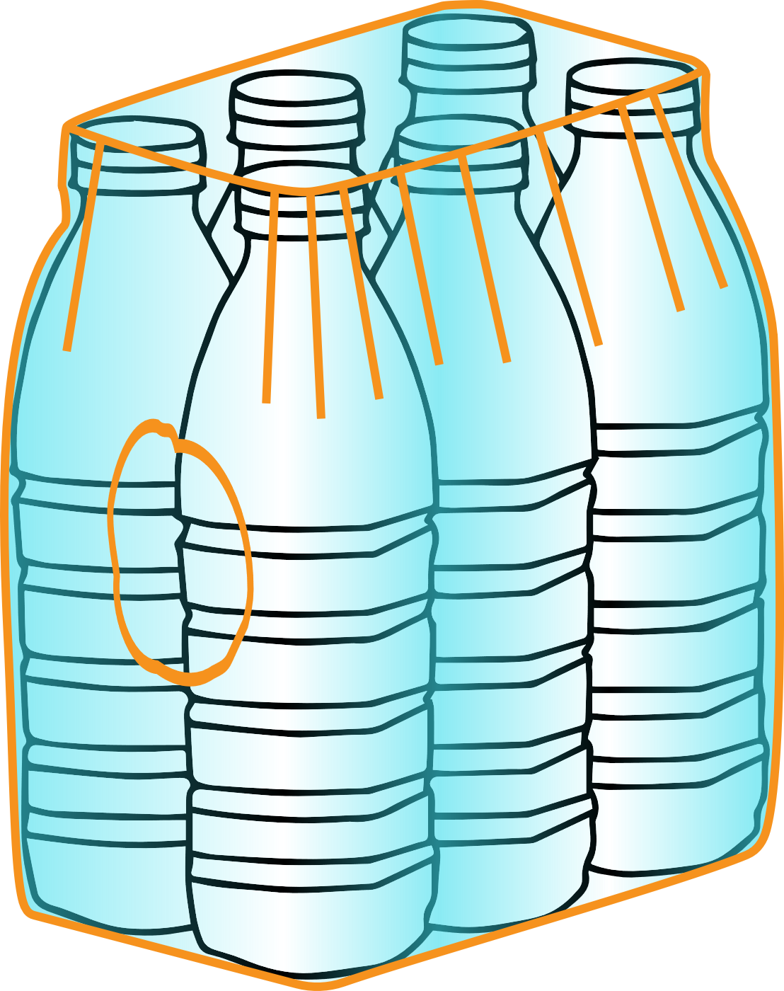

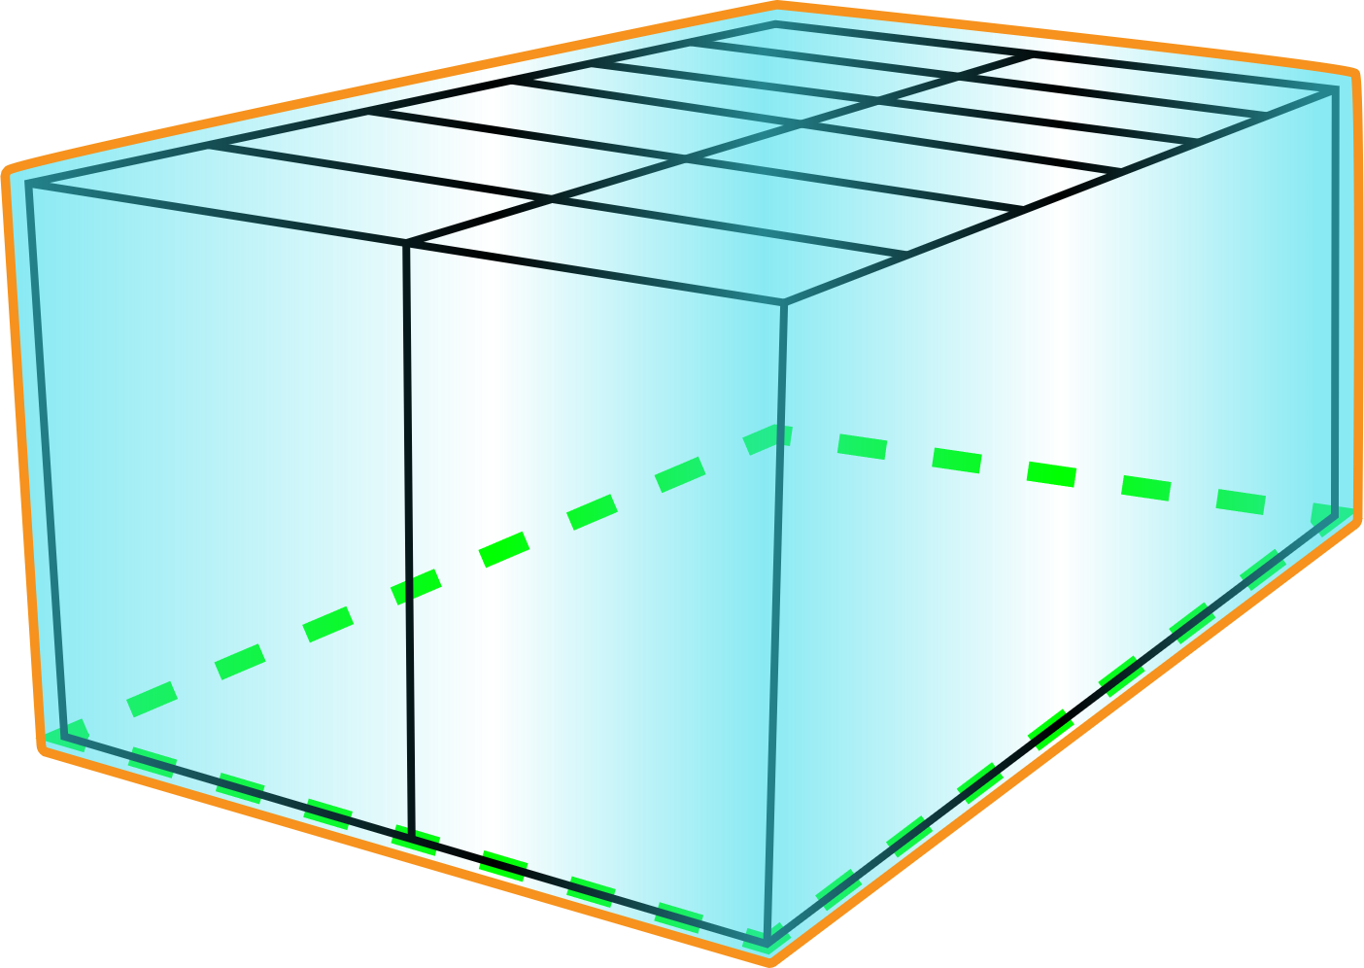



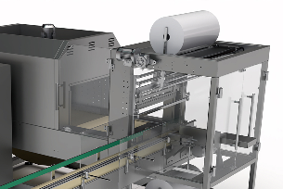
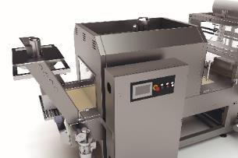
SHRINK WRAPPING MACHINE
Speed: up to 1,200 boxes/hr (20 boxes/min) (e.g., 2x3 bundle, 7,200 pcs/hr)
Secondary Packaging
Bundle with film only
Bundle with film and vertical liner
Bundle with film and pad (e.g., 2x3 bundle, up to 10 bundles/min, 3,600 pcs/hr)
Bundle for tray with film
General Features
Low-consumption retraction oven
Quick changeover
Film thickness range: 25-100 micron

Slide 10











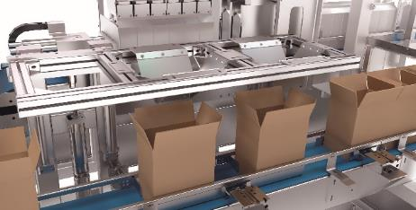
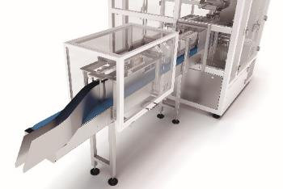
PICK & PLACE
Speed: up to 1,200 cases/hr (20 cases/min)
Primary and secondary Packaging
Trays
American Box
Closure types
Format changeovers depending on pack volume/bundle requirements
Tape
Hot glue

Slide 11



TRAY FORMING MACHINE
Speed: up to 1,800 trays/hr (30 trays/min)
Configurations
Glued tray
Tray with tuck lock corners
Tray with lid

Slide 12







AUXILIARY EQUIPMENT
Speed: up to 20,000 straws/hr or 10,000 spoons/hr (top application)
up to 14.000 straws/hr or 7,000 spoons/hr (side application)
Straw and Spoons Applicator
Secondary Packaging
Changeover
Straw type and length
General Features
Options
x2
By-pass for products with no stray/spoon
Electrical cabinet and glue unit are in the upper part of the machine
Additional application head for second straw format or double straw application

Slide 13
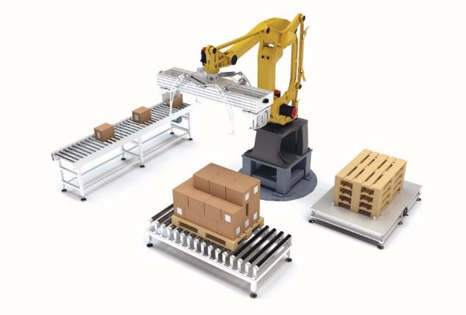



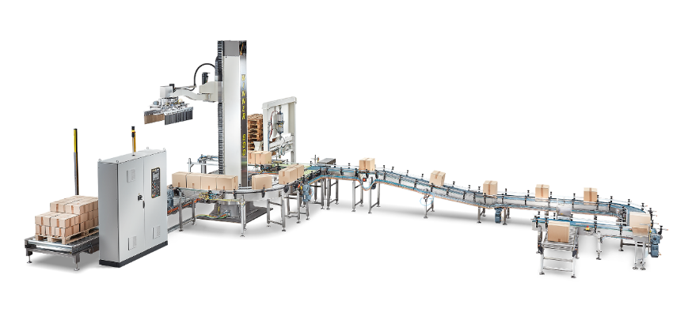


PALLETISER
Speed: up to 780 cycles/hr
Anthropomorphic or Cartesian Robots
Accessories
Gripping systems with vacuum suction cups
Grippers and gripping systems for boxes, pallets, cardboard flaps
Operational feedback sensors
Additional equipment
Robot types
Format changeovers depending on pack volume/bundle requirements
Pallet de-stacker;
Cardboard interlayer magazine;
Pallet wrapping unit;
Ink-jet printers and labelling units
Anthropomorphic or Cartesian robots

Slide 14






AUTOMATION AND HANDLING
General Features
Additional equipment
Conveyor system with plastic anti-friction rollers and stainless steel frame
Transport management and control with hardware and software system integration
Conveyor belts
Sorting systems
Lifting units
By-pass and accumulation units

Slide 15
SUCCESSFUL CASE STUDIES
SUCCESSFUL CASE STUDIES

Slide 16

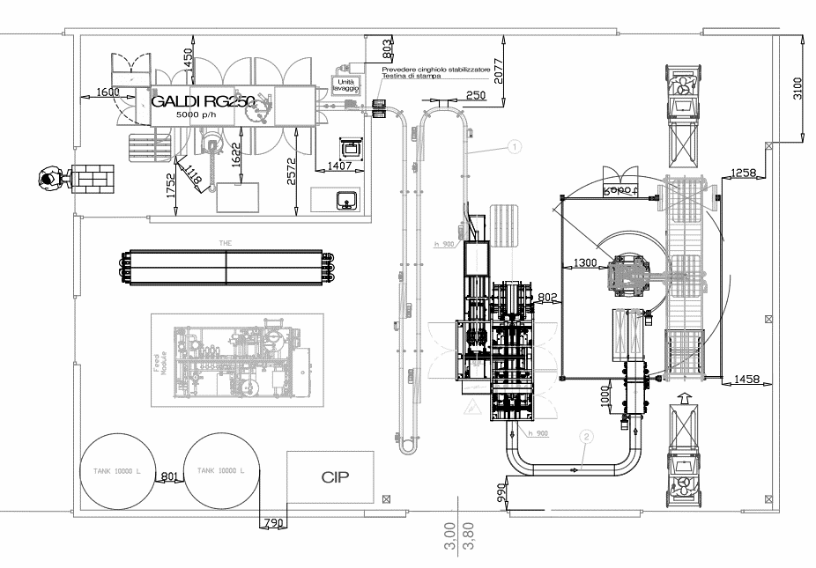






ORANFRIZER JUICE, ITALY
Primary Packaging
Secondary Packaging
Gable Top
Full case
8 Formats
Solution
Wrap Around

Slide 17


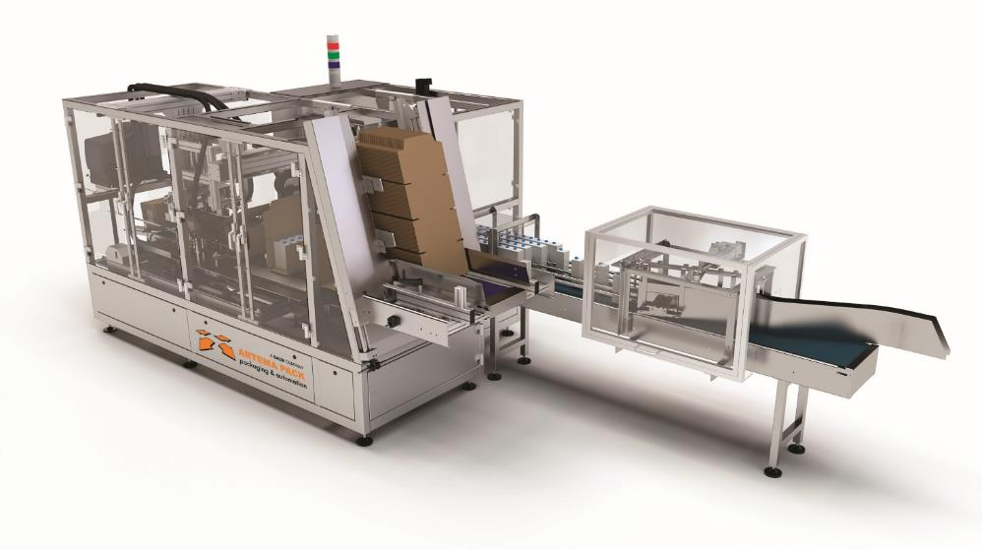






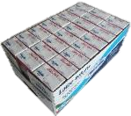
FRASCHERI, ITALY
Primary Packaging
Secondary Packaging
Gable Top
Base
Square
Full Case (with lid)
Tray
10 Formats
Solution
Wrap Around

Slide 18

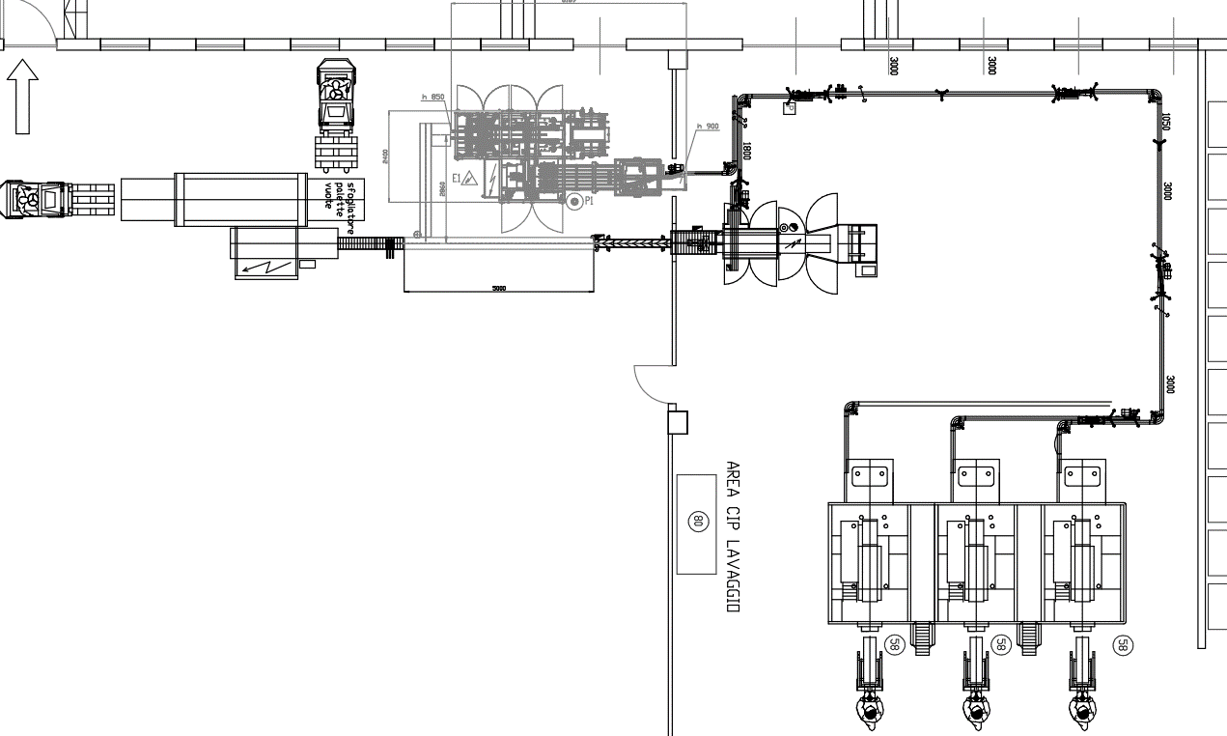


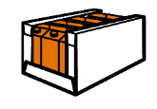


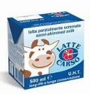
LATTE CARSO, ITALY
Primary Packaging
Secondary Packaging
FULL CASE
TRAY
Base
Square
SHOULDERS TRAY
14 Formats
Solution
Wrap Around

Slide 19

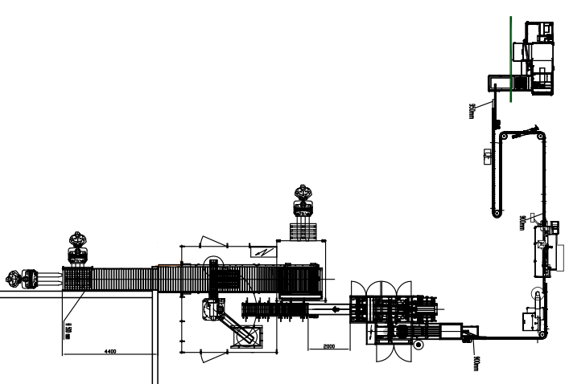



POLICOM, ITALY
Primary Packaging
Secondary Packaging
Brik
Full case (with lid)
3 Formats
Solution
Wrap Around

Slide 20

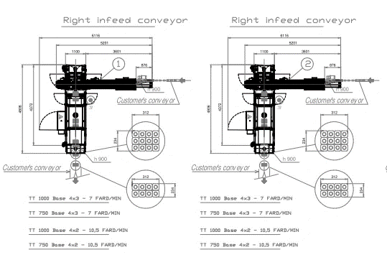

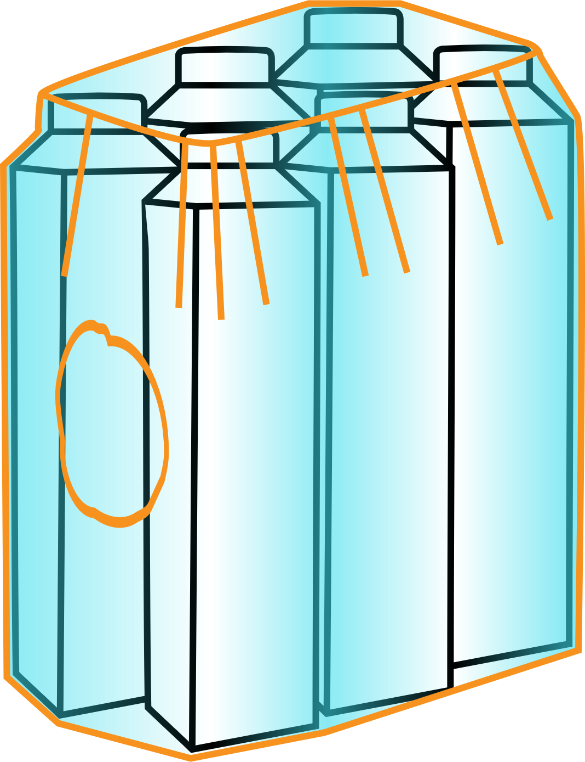
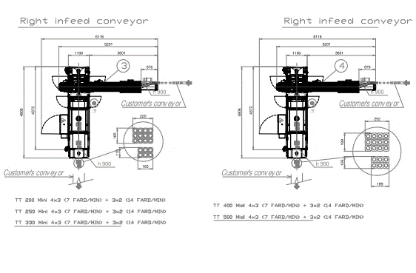





IMLEK, serbia
Primary Packaging
Secondary Packaging
Tetra Top
Shrink Wrap
4 Formats
Solution
Shrink Wrapping Machine TE-830

Slide 21





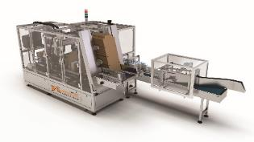
AQUAFRESH, Ghana
Primary Packaging
Secondary Packaging
Brik
Tray
3 Formats
Solution
Wrap Around

Slide 22





RUGANI, SOUTH Africa
Primary Packaging
Secondary Packaging
Brik
Full case
(with lid)
3 Formats
Solution
Wrap Around

Slide 23
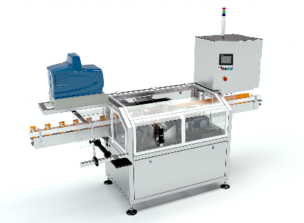

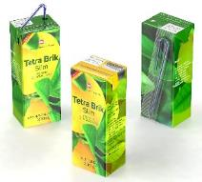
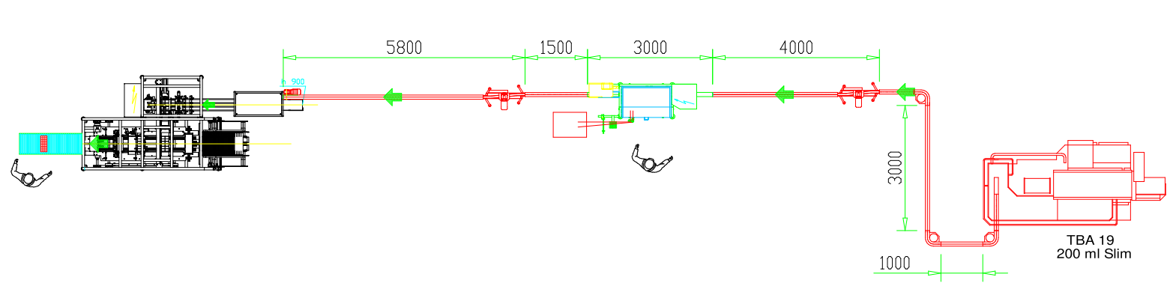
MPZ, Albania
Primary Packaging
Secondary Packaging
1 Format
Solution
Tetra Brik slim 200 ml
Straw
Tray
Straw Applicator AC-750
Wrap Around

Slide 24
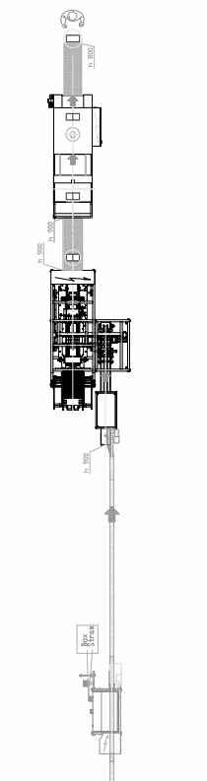

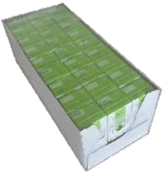

BENCHEKOR, Algeria
Primary Packaging
Secondary Packaging
1 Format
Solution
Tetra Brik slim 200 ml
Straw
Tray
Shrink Wrap
Straw Applicator AC-750
Wrap Around
Shrink Wrapping Machine TE-830

Slide 25
Thank you

